Slide 1


Social Buzz:
Content Analysis
Notes:
"Welcome to the presentation on 'SocaiL Buzz - Content Analysis.' Today, we'll delve into the insights derived from our data analysis, focusing on customer engagement across various content categories. Let’s explore how we turned raw data into actionable insights to guide our strategies."

Slide 2


Today's agenda
Project recap:
This project focused on helping Socialbuzz, a social media company, manage large datasets to make informed decisions, particularly regarding an IPO and identifying the top 5 content categories.
Problem:
The primary challenge was handling large datasets by extracting, cleaning, and analyzing the data to support critical business decisions.
The Analytics Team:
As a key member of the analytics team, I was responsible for data extraction, cleaning, and deriving actionable insights.
Process:
We systematically extracted, cleaned, and analyzed the data to ensure its accuracy and relevance for making informed decisions.
Insights:
The analysis uncovered the top 5 content categories that could significantly drive user engagement and influence strategic planning.
Summary:
Successfully retrieved, cleaned, and analyzed large datasets, providing critical insights that supported Socialbuzz's IPO considerations and content strategy.
Notes:
"Today's agenda will cover the following key points:
Project Recap:
Focus: This project aimed to assist Socialbuzz, a social media company, in managing large datasets to make informed decisions, especially related to their IPO and identifying the top 5 content categories.
Problem:
Challenge: The main difficulty was handling extensive datasets, which involved extracting, cleaning, and analyzing data to support crucial business decisions.
The Analytics Team:
My Role: As a key member of the analytics team, my responsibilities included data extraction, cleaning, and deriving actionable insights.
Process:
Approach: We methodically extracted, cleaned, and analyzed the data to ensure its accuracy and relevance for informed decision-making.
Insights:
Findings: Our analysis identified the top 5 content categories that could significantly enhance user engagement and guide strategic planning.
Summary:
Outcome: We successfully managed large datasets, providing critical insights that supported Socialbuzz's IPO considerations and content strategy."

Slide 3

Client Background: Social Buzz, founded in 2010, has scaled to 500M+ active users, focusing on anonymous, content-centric user engagement.
Problem Statement: Rapid growth led to challenges in managing vast unstructured data and preparing for an IPO, requiring external expertise for guidance.
Our Role: Conducted a comprehensive big data audit, extracted and analyzed sample datasets, and provided strategic recommendations for IPO preparation.
Key Insights: Identified top 5 content categories driving user engagement and uncovered weak points in technology infrastructure for future scalability.
Outcome: Delivered actionable insights and recommendations that positioned Social Buzz for successful scaling and a smooth IPO process.
Project Recap
Notes:
"Let’s dive into the project recap:
Client Background:
Social Buzz, established in 2010, has grown to over 500 million active users. The company focuses on anonymous and content-centric user engagement.
Problem Statement:
Due to rapid growth, Social Buzz faced challenges in managing vast amounts of unstructured data. With an upcoming IPO, they required external expertise to navigate these issues effectively.
Our Role:
We conducted a thorough audit of their big data systems, extracted and analyzed sample datasets, and offered strategic recommendations to assist with IPO preparation.
Key Insights:
We identified the top 5 content categories that drive user engagement and pinpointed weak areas in their technology infrastructure that need addressing for future scalability.
Outcome:
Our work provided actionable insights and recommendations, helping Social Buzz position itself for successful scaling and a smooth IPO process."

Slide 4

Problem
Data Overload:
Managing over 100,000 daily pieces of unstructured content, from text to videos, is challenging.
Scaling Issues:
Rapid growth to 500M+ users has stretched their resources and infrastructure.
IPO Preparation:
They need help navigating the complex process of going public next year.
Technology Strain:
Their current systems are struggling to handle the growing data volume.
Best Practices Needed:
They lack experience in large-scale data management, essential for future growth.
Notes:
"Now, let’s explore the key problems Social Buzz faced:
Data Overload:
Managing over 100,000 daily pieces of unstructured content—ranging from text to videos—presents a significant challenge.
Scaling Issues:
The rapid expansion to over 500 million users has stretched their resources and infrastructure to its limits.
IPO Preparation:
With plans to go public next year, Social Buzz needs expert guidance to navigate the complexities of the IPO process.
Technology Strain:
Their current systems are struggling to keep up with the growing volume of data.
Best Practices Needed:
They lack the necessary experience in large-scale data management, which is crucial for supporting their future growth.

Slide 5
Data Analyst(Isha KC)
Primary Responsibility: Conduct hands-on data analysis
Key Task: Translate project requirements into actionable insights
Focus:
Ensure data cleanliness and accuracy
Make data useful for decision-making
Outcome:
Deliver insights that drive strategic decisions
Support project goals
Data Scientist (Michelle Grove)
Primary Responsibility:
Collaborate with the data team
Develop predictive models and algorithms
Key Task:
Forecast future active users
Create scalable solutions for client needs
Outcome:
Provide forecasts and models to guide strategic planning
The Analytics team
Notes:
"Here’s a brief overview of our analytics team roles:
Data Analyst (Isha KC):
Role: Conducts data analysis and translates requirements into insights.
Focus: Ensures data accuracy and usefulness for decision-making.
Outcome: Provides actionable insights to support project goals.
Data Scientist (Michelle Grove):
Role: Develops predictive models and algorithms.
Focus: Forecasts future user activity and creates scalable solutions.
Outcome: Offers forecasts and models for strategic planning."

Slide 6
Understanding the Project Brief
Process
1
2
Data acquisition
3
Data Cleaning and Modelling
4
Data Analyisis and Insights
5
Sharing Insights and Presentation

Slide 7
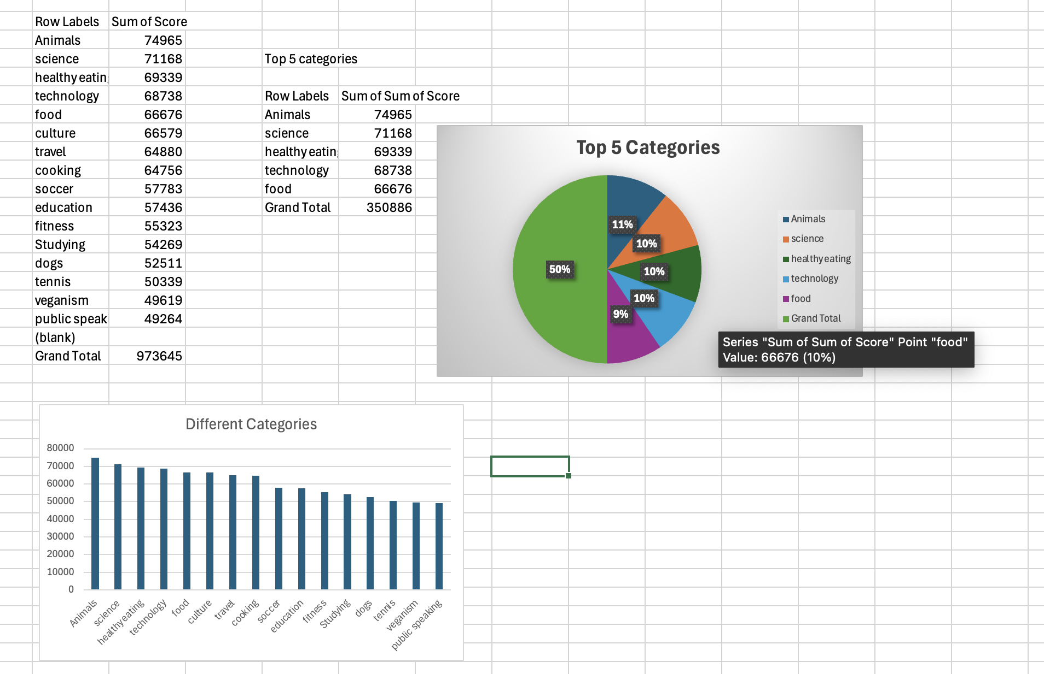

Insights

Slide 8
Upon analysis, The top 5 categories are:
Animals
Science
Healthy Eating
Technology
Food
These are all based on the customer likability score based on total points secured in each of the categories.
Notes:
"Based on our analysis, the top 5 content categories are:
Animals
Science
Healthy Eating
Technology
Food
These rankings are determined by customer likability scores, reflecting the total points secured in each category."

Slide 9
How were the insights generated?
I thoroughly cleaned the data available in 3 tables- reactions, content and reaction types.
Initially to expand further, I used google colab and python to clean and preparation data. However it added further complexity compared to Excel.
The insight is generated through Microsoft Excel focusing on data accuracy with all data having no null values. Hence, it is accurate.
Notes:
"Here’s how the insights were generated:
Data Preparation:
Cleaned data from three tables: Reactions, Content, and Reaction Types.
Tools Used:
Initially used Google Colab and Python for data cleaning but found it more complex.
Finalized analysis using Microsoft Excel to ensure data accuracy and eliminate null values.
Outcome:
Insights were derived with high confidence in their accuracy due to thorough data cleaning and validation in Excel."

Slide 10

This analysis of content of Social Buzz helped us understand the 5 top categories and now this can be used to streamline and focus more on adding content for these categories.
Furthermore, Social Buzz can use the help of big data technologies by focusing on content that is relevant.
Summary
Notes:
"In summary, this analysis identified the top 5 content categories for Social Buzz. By focusing on these categories, Social Buzz can streamline content creation and enhance user engagement. Additionally, leveraging big data technologies to focus on relevant content will further support their growth and strategy."

Slide 11

Thank you!
ANY QUESTIONS?

